Slide 1
Number Systems and Data Representation.

Slide 2
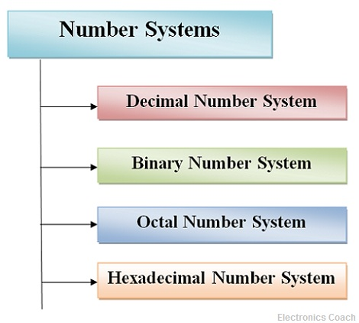
Number System
A number system is defined as a system of writing for expressing numbers. It is the mathematical notation for representing numbers of a given set by using digits or other symbols in a consistent manner.

Slide 3
Positional Number
A number is represented by a string of a digits where each digit position has an associated weight.
The weight is based on the radix of the number System.

Slide 4
Non-Positional Number
Non-positional number system is used for personal accounting method. In non-weighted number system, there is a huge symbol to represent any number. In non-positional number system, each symbol represents the same value regardless of its position. e.g. Roman style as I, II, III, IV etc.

Slide 5
Common Number Systems
System | Base | Symbols | Used by humans? | Used in computers?
Decimal | 10 | 0, 1, … 9 | Yes | No
Binary | 2 | 0, 1 | No | Yes
Octal | 8 | 0, 1, … 7 | No | No
Hexa- decimal | 16 | 0, 1, … 9, A, B, … F | No | No

Slide 6
Quantities/Counting (1 of 3)
Decimal | Binary | Octal | Hexa- decimal
0 | 0 | 0 | 0
1 | 1 | 1 | 1
2 | 10 | 2 | 2
3 | 11 | 3 | 3
4 | 100 | 4 | 4
5 | 101 | 5 | 5
6 | 110 | 6 | 6
7 | 111 | 7 | 7
p. 33

Slide 7
Quantities/Counting (2 of 3)
Decimal | Binary | Octal | Hexa- decimal
8 | 1000 | 10 | 8
9 | 1001 | 11 | 9
10 | 1010 | 12 | A
11 | 1011 | 13 | B
12 | 1100 | 14 | C
13 | 1101 | 15 | D
14 | 1110 | 16 | E
15 | 1111 | 17 | F

Slide 8
Quantities/Counting (3 of 3)
Decimal | Binary | Octal | Hexa- decimal
16 | 10000 | 20 | 10
17 | 10001 | 21 | 11
18 | 10010 | 22 | 12
19 | 10011 | 23 | 13
20 | 10100 | 24 | 14
21 | 10101 | 25 | 15
22 | 10110 | 26 | 16
23 | 10111 | 27 | 17

Slide 9
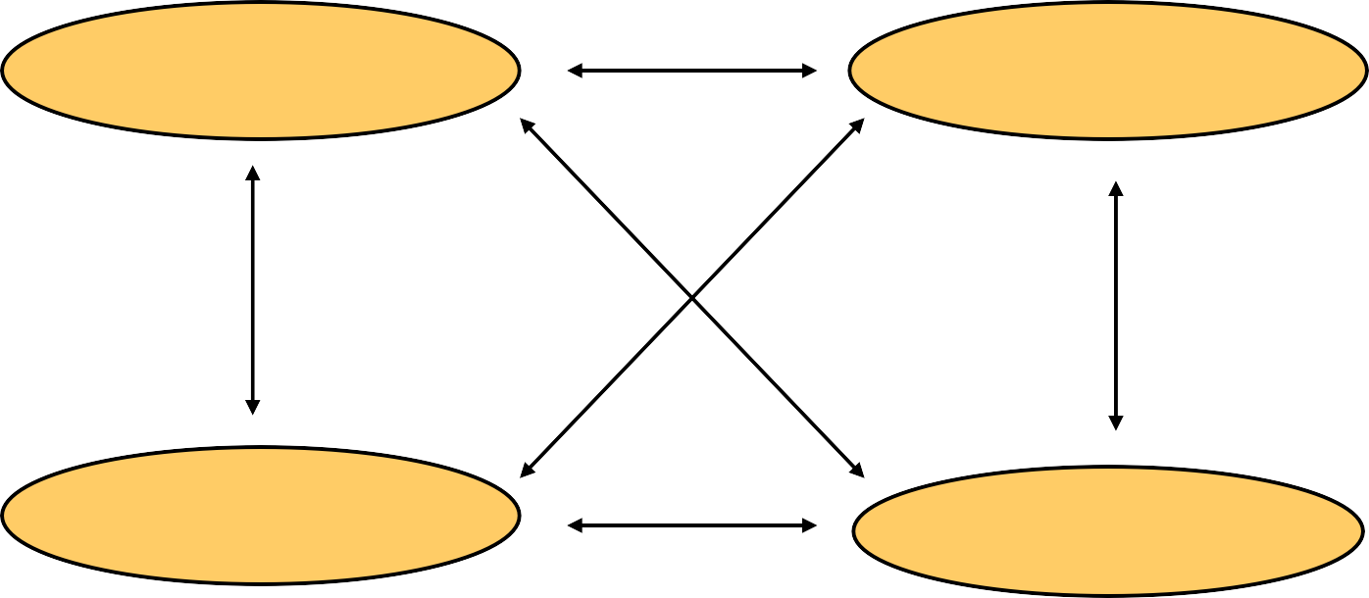
Conversion Among Bases
The possibilities:
Decimal
Octal
Binary
Hexadecimal

Slide 10
Example
25₁₀ = 11001₂ = 31₈ = 19₁₆
Base

Slide 11
Decimal to Decimal
Decimal
Octal
Binary
Hexadecimal
Next slide…

Slide 12
Weight
125₁₀ | => | 5 | x | 10⁰ | = | 5
 |  | 2 | x | 10¹ | = | 20
1 |  |  | x | 10² | = 100
 |  |  |  |  | 125
Base

Slide 13
Binary to Decimal
Decimal
Octal
Binary
Hexadecimal

Slide 14
Binary to Decimal
Technique
Multiply each bit by 2^{n}, where n is the “weight” of the bit
The weight is the position of the bit, starting from 0 on the right
Add the results

Slide 15
Example
Bit “0”
101011₂ | => | 1 | x
 |  | 1 | x
 |  | 0 | x
 |  | 1 | x
 |  | 0 | x
 |  | 1 | x
₂0
₂1
₂2
₂3
₂4
₂5
= | 1
= | 2
= | 0
= | 8
= | 0
= | 32
 | 43₁₀

Slide 16
Octal to Decimal
Decimal
Octal
Binary
Hexadecimal

Slide 17
Octal to Decimal
Technique
Multiply each bit by 8^{n}, where n is the “weight” of the bit
The weight is the position of the bit, starting from 0 on the right
Add the results

Slide 18
Example
₈0
₈1
₈2
= 4
= 16
= 448
468₁₀
724₈ | => | 4 | x
 |  | 2 | x
 |  | 7 | x

Slide 19
Hexadecimal to Decimal
Decimal
Octal
Binary
Hexadecimal

Slide 20
Hexadecimal to Decimal
Technique
Multiply each bit by 16^{n}, where n is the “weight” of the bit
The weight is the position of the bit, starting from 0 on the right
Add the results

Slide 21
Example
ABC₁₆ | => | C | x | 16⁰ | = | 12 | x | 1 | = | 12
 |  | B | x | 16¹ | = | 11 | x | 16 | = | 176
 |  | A | x | 16² | = | 10 | x | 256 | = | 2560
2748₁₀

Slide 22
Decimal to Binary
Decimal
Octal
Binary
Hexadecimal

Slide 23
Decimal to Binary
Technique
Divide by two, keep track of the remainder
First remainder is bit 0 (LSB, least-significant bit)
Second remainder is bit 1
Etc.

Slide 24
Example
125₁₀ = ?₂
2 125
2 62 1
2 31 0
2 15 1
2 7 1
2 3 1
2 1 1
0 1
125₁₀ = 1111101₂

Slide 25
Octal to Binary
Decimal
Octal
Binary
Hexadecimal

Slide 26
Octal to Binary
Technique
– Convert each octal digit to a 3-bit equivalent binary representation

Slide 27
Example
705₈ = ?₂
7 0 5
111 000 101
705₈ = 111000101₂

Slide 28
Hexadecimal to Binary
Decimal
Octal
Binary
Hexadecimal

Slide 29
Hexadecimal to Binary
Technique
– Convert each hexadecimal digit to a 4-bit equivalent binary representation

Slide 30
Example
10AF₁₆ = ?₂
1
0
A
F
0001 0000 1010 1111
10AF₁₆ = 0001000010101111₂

Slide 31
Decimal to Octal
Decimal
Octal
Binary
Hexadecimal

Slide 32
Decimal to Octal
Technique
Divide by 8
Keep track of the remainder

Slide 33
Example
1234₁₀ = ?₈
8 1234
8 154 2
8 19 2
8 2 3
0 2
1234₁₀ = 2322₈

Slide 34
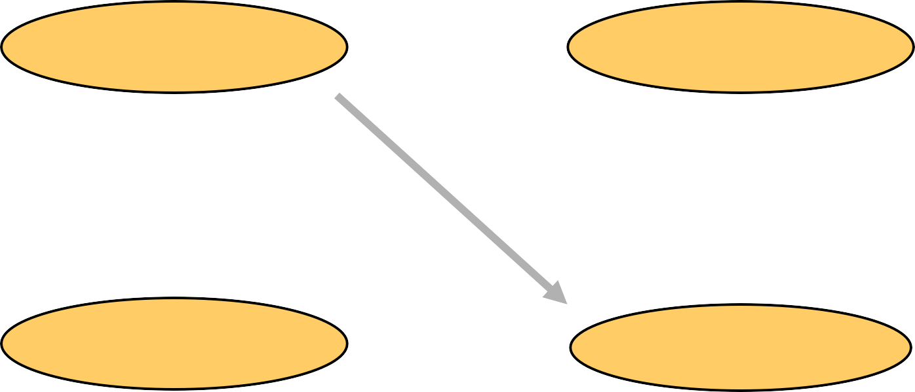
Decimal to Hexadecimal
Decimal
Octal
Binary
Hexadecimal

Slide 35
Decimal to Hexadecimal
Technique
Divide by 16
Keep track of the remainder

Slide 36
Example
1234₁₀ = ?₁₆
 | 16 | 1234
 | 16 | 77 | 2
 | 16 | 4 | 13 | = | D
 |  | 0 | 4
1234₁₀ = 4D2₁₆

Slide 37
Binary to Octal
Decimal
Octal
Binary
Hexadecimal

Slide 38
Binary to Octal
Technique
Group bits in threes, starting on right
Convert to octal digits

Slide 39
Example
1011010111₂ | = | ?₈
 |  | 1 | 011 | 010 | 111
 |  | 1 | 3 | 2 | 7
1011010111₂ = 1327₈

Slide 40
Binary to Hexadecimal
Decimal
Octal
Binary
Hexadecimal

Slide 41
Binary to Hexadecimal
Technique
Group bits in fours, starting on right
Convert to hexadecimal digits

Slide 42
Example
1010111011₂ = ?₁₆
10 1011 1011
2
B
B
1010111011₂ = 2BB₁₆

Slide 43
Octal to Hexadecimal
Decimal
Octal
Binary
Hexadecimal

Slide 44
Octal to Hexadecimal
Technique
– Use binary as an intermediary

Slide 45
Example
1076₈ = ?₁₆
1
0
7
6
001 000 111 110
2
3
E
1076₈ = 23E₁₆

Slide 46
Hexadecimal to Octal
Decimal
Octal
Binary
Hexadecimal

Slide 47
Hexadecimal to Octal
Technique
– Use binary as an intermediary

Slide 48
Example
1F0C₁₆ = ?₈
1
F
0
C
0001 1111 0000 1100
1 7 4
1
4
1F0C₁₆ = 17414₈

Slide 49
Exercise – Convert ...
Decimal | Binary | Octal | Hexa- decimal
33
 | 1110101
 |  | 703
 |  |  | 1AF
Don’t use a calculator!
Skip answer
Answer

Slide 50
Exercise – Convert …
Answer
Decimal | Binary | Octal | Hexa- decimal
33 | 100001 | 41 | 21
117 | 1110101 | 165 | 75
451 | 111000011 | 703 | 1C3
431 | 110101111 | 657 | 1AF

Slide 51
Binary Addition
Two 1-bit values
A | B | A + B
0 | 0 | 0
0 | 1 | 1
1 | 0 | 1
1 | 1 | 10
“two”

Slide 52
Binary Addition
Two n-bit values
Add individual bits
Propagate carries
– E.g.,
1
1
10101
21
+ 11001 + 25
46
101110

Slide 53
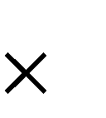
Multiplication
Binary, two 1-bit values
A | B | A B
0 | 0 | 0
0 | 1 | 0
1 | 0 | 0
1 | 1 | 1

Slide 54
Multiplication
Binary, two n-bit values
– As with decimal values
– E.g.,
1110
x 1011
1110
1110
0000
1110
10011010

Slide 55
Binary Subtraction
https://www.youtube.com/watch?v=PQ7cU31968c

Slide 56
Thank you

